Slide 1

PROJECT PRESENTATION “FACIAL CERTIFICATION SHIELD”
MASTER OF COMPUTER APPLICATION
KANNUR UNIVERSITY
2015-2018

Slide 2

“FACIAL CERTIFICATION SHIELD”
NEETHA C
B5GMCA2123

Slide 3
INTRODUCTION
“Facial Certification Shield(FCS)” is an application to maintain the security of documents and to prevent impersonation.
creating a unique ID based on the feature points extracted from the facial periocular region of an individual
The unique ID is converted to QR code and it is printed in the security documents for one to one verification

Slide 4
SYSTEM ANALYSIS
Several methods were available for collecting the requirements.
I choose the following methods.
Interview
Website visit
Questionnaire

Slide 5
EXISTING SYSTEM
Limitations:
Manual effort is more
Time consuming process
Difficult to identify the original certificate
Unable to conduct person identification
Certificates are misused for impersonation

Slide 6
PROPOSED SYSTEM
Advantages of Proposed System:
Cost effective system
Time efficient system with minimum requirements
User authentication is possible using biometric features
Less manual effort
Reduce the misuse of certificates

Slide 7
FEASIBILITY STUDY
Economical feasibility
Technical feasibility
Behavioral feasibility
Legal feasibility

Slide 8

ACTOR IDENTIFICATION
1. | Who will use the main functionality of the system? | Administrator, College, Student, Verifier
2. | Who will lead support from the system and do their daily tasks? | Administrator, College, Student, Verifier
3. | Who will maintain and administrate the system? | Administrator
4. | Which hardware devices does the system need to handle? | Mobile phone, Tablet
5. | With which other systems, does this system need to interact? | Database
6. | Who was interest in the result produced by the system? | Administrator, College,Student, Verifier

Slide 9
CONTINUE…
Actors of the system are:
Administrator
College
Student
Verifier

Slide 10

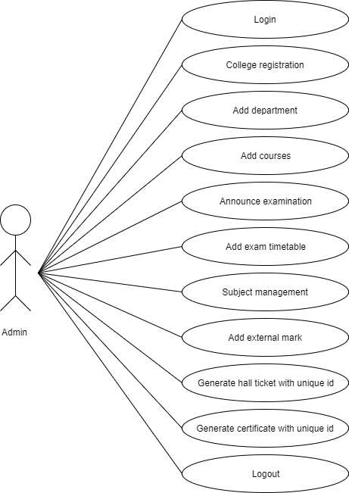
USECASE DIAGRAM FOR ACTOR ADMIN

Slide 11

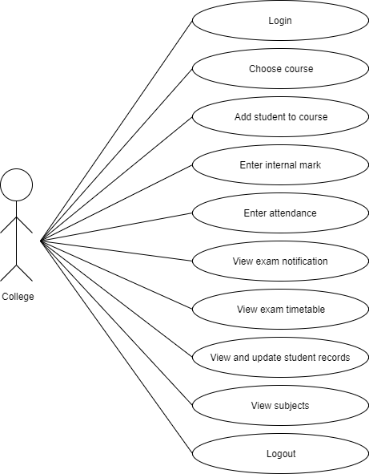
USECASE DIAGRAM FOR ACTOR COLLEGE

Slide 12

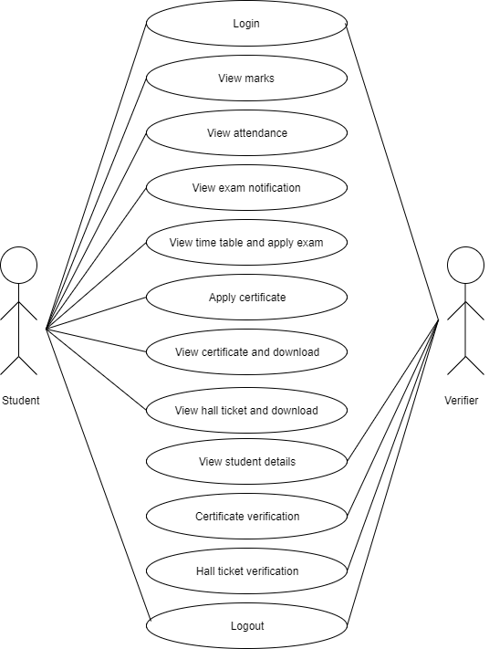
USECASE DIAGRAM FOR ACTOR STUDENT AND VERIFIER

Slide 13
ACTIVITY DIAGRAM
Activity diagram is an important diagram in UML to describe aspects of the system.
Activity diagram is basically a flow chart to represent flow from one activity to another activity

Slide 14
ACTIVITY DIAGRAM FOR ADMIN
No
Yes
College registration
Add department
Subject management
View request and generate certificate with unique id
Logout

Slide 15

ACTIVITY DIAGRAM FOR COLLEGE
No
Yes
Choose course
Add student to course
View exam notification
Logout

Slide 16

ACTIVITY DIAGRAM FOR STUDENT
No
Yes
View marks
View attendance
View exam time table and apply exam
View hall ticket and download
Logout

Slide 17

ACTIVITY DIAGRAM FOR VERIFIER
Login
Authenticate?
No
Yes
View student details
Certificate verification
Hall ticket verification
Logout

Slide 18

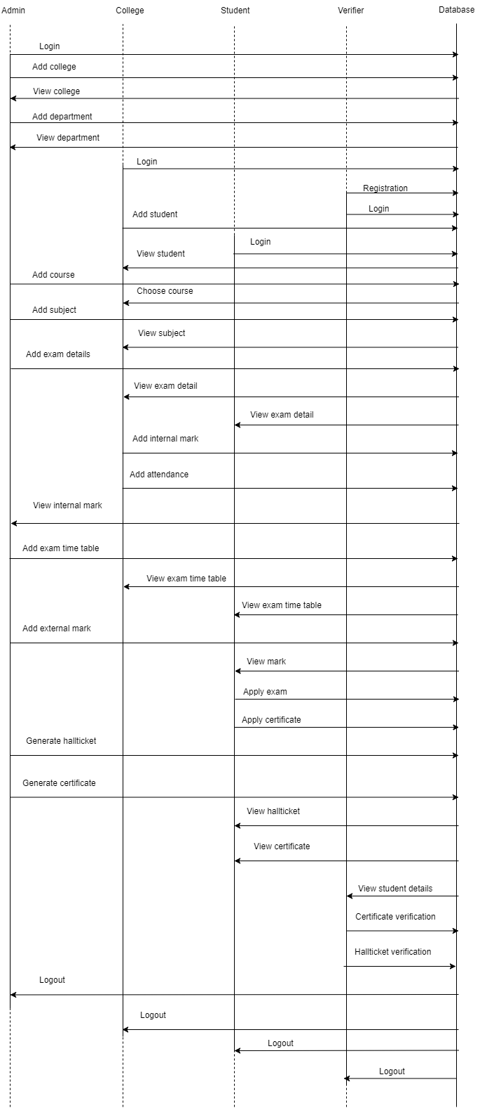
SEQUENCE DIAGRAM

Slide 19

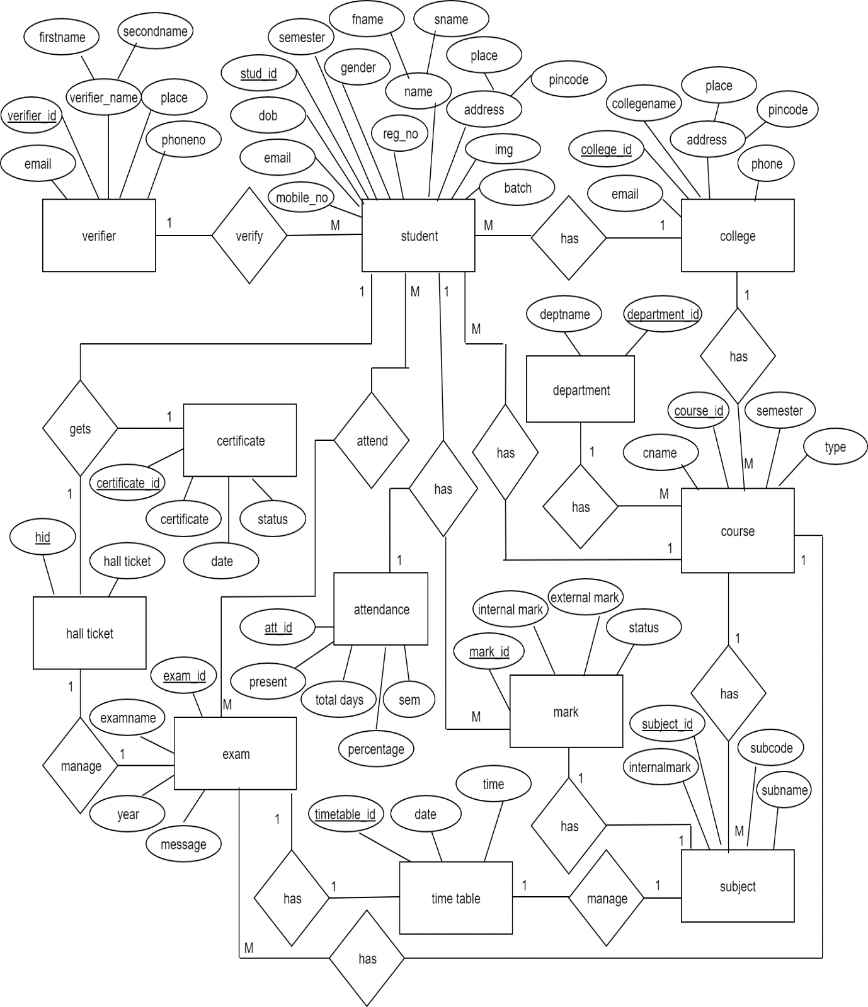
ER DIAGRAM

Slide 20
TABLE DESIGN
Table 1:login_tbl
Field Name | Data Type | Constraints | Description
login_id | int | Primary key | Primary key
username | varchar(40) | Not null | Username
password | varchar(15) | Not null | Password
type | varchar(15) | Not null | User type
Table 2:college_tbl
Field Name | Data type | Constraints | Description
college_id | int | Primary key | Primary Key
login_id | int | Foreign key | Login id
collegename | varchar(20) | Not null | Name of college
Place | varchar(20) | Not null | Place of college
pincode | varchar(6) | Not null | Pincode
email | varchar(40) | Not null | College email id
phone | varchar(15) | Not null | Phone no of college

Slide 21
Table 3:department_tbl
Field Name | Data Type | Constraints | Description
department_id | int | Primary key | Department id
deptname | varchar(15) | Not null | Department name
Table 4:course_tbl
Field Name | Data Type | Constraints | Description
course_id | int | Primary key | Course id
department_id | int | Foreign key | Department id
cname | varchar(15) | Not null | Course name
semester | varchar(15) | Not null | Total semesters
type | varchar(15) | Not null | Type of course
Table 5:course_college_tbl
Field Name | Data Type | Constraints | Description
id | int | Primary key | Course id of colleges
course_id | int | Foreign key | Course id
college_id | int | Foreign key | College id

Slide 22
Table 6:student_tbl
Field Name | Data Type | Constraints | Description
stud_id | int | Primary key | Primary key
login_id | int | Foreign key | login id
course_id | int | Foreign key | Course id of college
college_id | int | Foreign key | College id
fnarme | varchar(15) | Not null | First name of student
sname | varchar(15) | Not null | Seconname of student
gender | varchar(6) | Not null | Gender of student
dob | varchar(15) | Not null | Date of birth
place | varchar(20) | Not null | Place of student
pincode | varchar(6) | Not null | Pin code
email | varchar(40) | Not null | Email id of student
mobile_no | varchar(10) | Not null | Mobile number
reg_no | varchar(15) | Not null | Register number
semester | varchar(10) | Not null | Semester of student
batch | varchar(10) | Not null | Batch of student
img | varchar(20) | Not null | Image of student
Table 7:cipher_tbl
Field Name | Data Type | Constraints | Description
cipher_id | int | Primary key | Primary key
stud_id | int | Foreign key | Student id
measurement | varchar(max) | Not null | Measurement

Slide 23
Table 8: attendance_tbl
Field Name | Data Type | Constraints | Description
att_id | int | Primary key | Attendance id
stud_id | int | Foreign key | student id
present | varchar(10) | Not null | Number of days present
totaldays | varchar(10) | Not null | Total working days
percentage | varchar(10) | Not null | Percentage of attendance
sem | varchar(10) | Not null | Semester
Table 9:subject_tbl
Field Name | Data Type | Constraints | Description
subject_id | int | Primary key | subject id
course_id | int | Foreign key | course id
subname | varchar(30) | Not null | Subject name
subcode | varchar(10) | Not null | Subject code
semester | varchar(10) | Not null | Semester
internalmark | varchar(15) | Not null | Internal mark of subject
externalmark | varchar(15) | Not null | External mark of subject

Slide 24
Table 10:exam_tbl
Field Name | Data Type | Constraints | Description
exam_id | int | Primary key | exam id
course_id | int | Foreign key | Course id
examname | varchar(20) | Not null | Name of exam
year | varchar(10) | Not null | Year of exam
message | varchar(30) | Not null | Notification about exam
semester | varchar(15) | Not null | Semester of exam
Table 11: mark_tbl
Field Name | Data Type | Constraints | Description
mark_id | int | Primary key | mark id
stud_id | int | Foreign key | Student id
subject_id | int | Foreign key | Subject id
internalmark | varchar(15) | Not null | Internal mark of student
extternalmark | varchar(15) | Not null | external mark of student
status | varchar(15) | Not null | Status of student

Slide 25
Table 12:timetable_tbl
Field Name | Data Type | Constraints | Description
timetable_id | int | Primary key | timetable id
subject_id | int | Foreign key | Subject id
exam_id | int | Foreign key | exam id
date | varchar(20) | Not null | Date of exam
time | varchar(10) | Not null | Time of exam
Table 13:exam_register_tbl
Field Name | Data Type | Constraints | Description
exam_register_id | int | Primary key | Exam register id
stud_id | int | Foreign key | student id
timetable_id | int | Foreign key | timetable id
Table 14:hallticket_tbl
Field Name | Data Type | Constraints | Description
hid | int | Primary key | Student hall ticket id
stud_id | int | Foreign key | student id
exam_id | int | Foreign key | exam id
hallticket | varchar(20) | Not null | Status of hall ticket

Slide 26
Table 15:certificate_tbl
Field Name | Data Type | Constraints | Description
certificate_id | int | Primary key | Student certificate id
stud_id | int | Foreign key | student id
certificate | varchar(20) | Not null | Certificate of student
date | varchar(20) | Not null | Date of certificate
status | varchar(15) | Not null | Status of certificate
Table 16:verifier_tbl
Field Name | Data Type | Constraints | Description
verifier_id | int | Primary key | Verifier id
login_id | int | Foreign key | Login id
firstname | varchar(15) | Not null | firstname of verifier
secondname | varchar(15) | Not null | secondname of verifier
place | varchar(20) | Not null | Place of verifier
email | varchar(40) | Not null | Email id of verifier
phoneno | varchar(15) | Not null | Phone number of verifier

Slide 27
TESTING
Unit testing
Integration testing
System testing
Validation testing

Slide 28
SYSTEM IMPLEMENTATION
Language : Android, Java
Database : MySQL
Web Server : GlassFish Server 4.1
Browser :Google Chrome
Development tool : Android Studio , NetBeans
Operating System : Windows 10

Slide 29
CONCLUSION
This system is essentially a web application that allows one to one verification for security documents.
This application is about development of Unique ID for the security of Certificates and hall tickets issued by university.
The proposed method is cost effective and efficient, since it has minimum requirements
To maintain the security of documents and to prevent impersonation this system can be use

Slide 30

REFERENCES
Website
www.stackoverflow.com
www.w3school.com
www.androidhive.info
http://www.tutorialspoint.com/java/
http://www.tutorialspoint.com/android/
http://www.youtube.com
Reference Books
“Ali Bahrami , “Object Oriented Systems development ", Tata McGraw-Hill Edition.
Roger S Pressman ,”Software engineering 5th edition”, McGraw-Hill publication 1987.

Slide 31

CONTINUE…
Research Papers
Sajan Ambadiyil, Haritha Sree G S, V P Mahadevan Pillai, “Facial Periocular Region based Unique ID Generation and One to One Verification for Security Documents ”
Linu Thomas, Tetas Mohod, Ranjit Thorat, Abhinandan Ohara, Manjushri Mahajan , “QR Code Based Security System Using IRIS Recognition ”
Wafaa A.N.A.AL-Nbhany, Ammar Zahary, “A Comparative Study among Cryptographic Algorithms: Blowfish, AES and RSA”
Soheila Omer AL Faroog, Dr.Amin Babiker A, “Comparison of Various Encryption Algorithms and Techniques for improving secured data Communication”

Slide 32
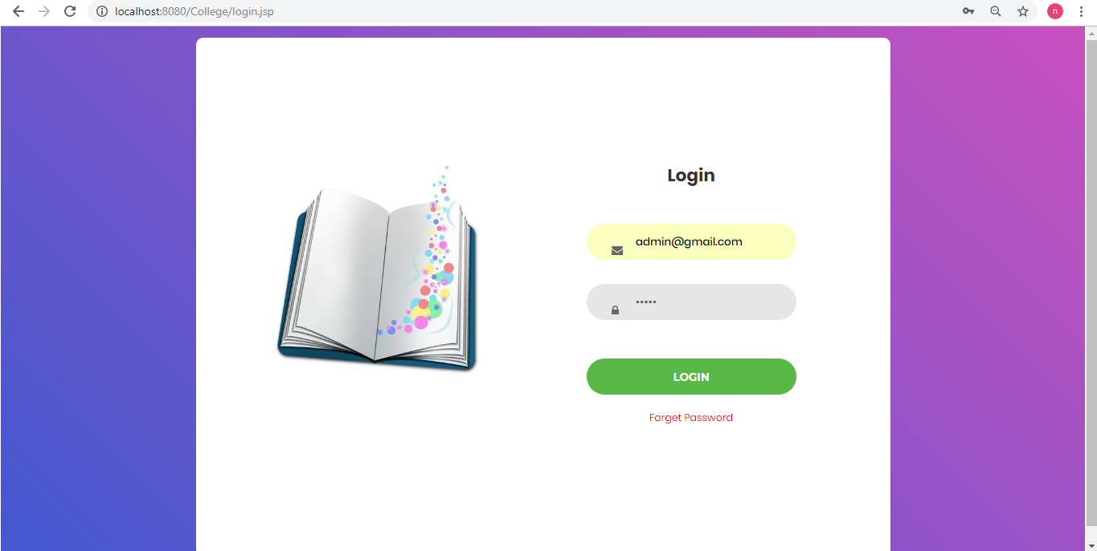
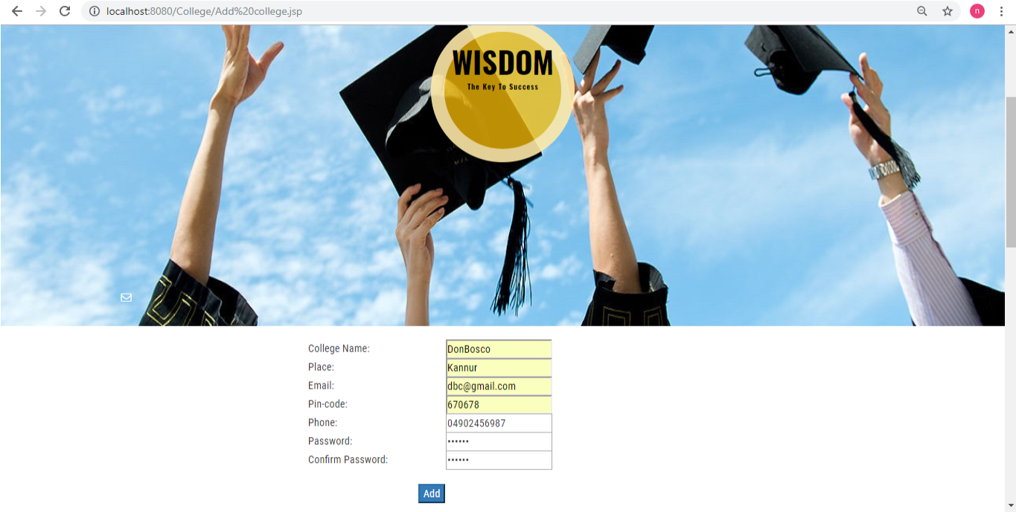
APPENDIX
Login form
Add college

Slide 33
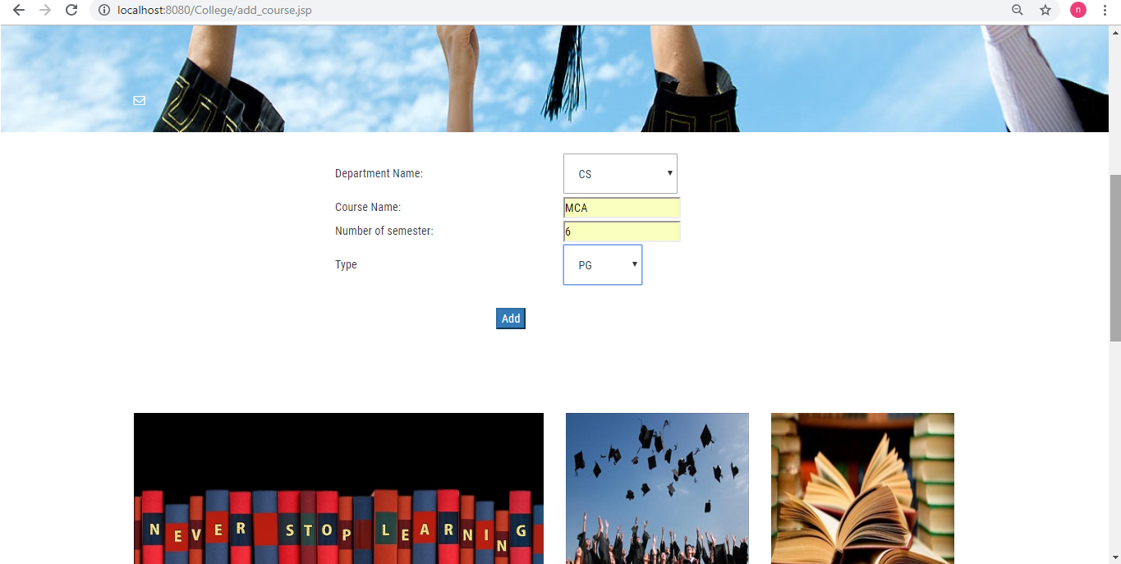
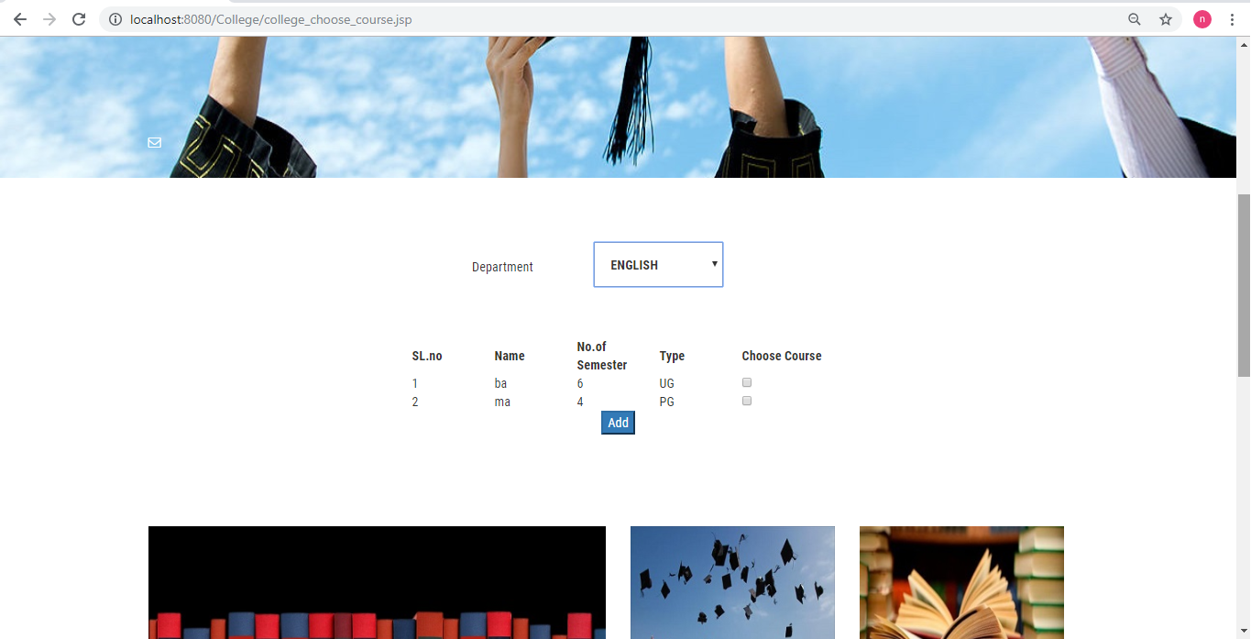
Add course
Choose course

Slide 34
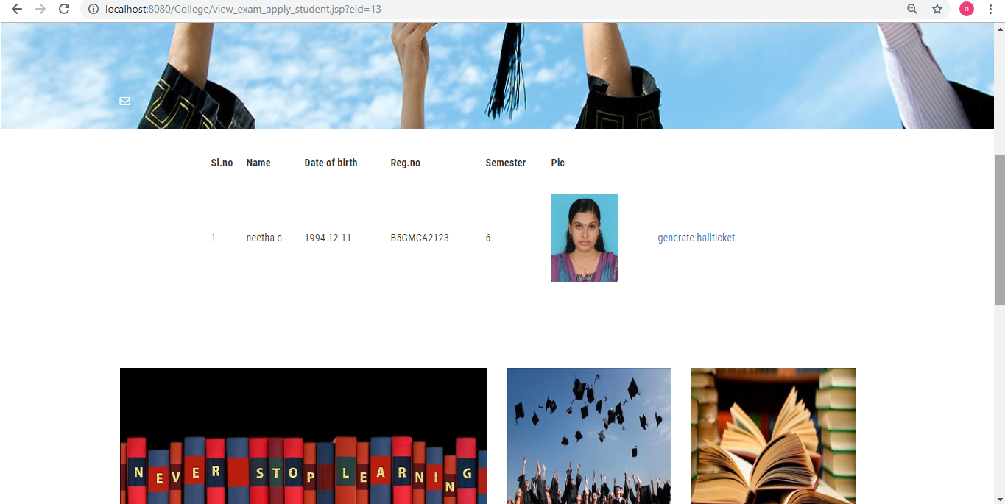
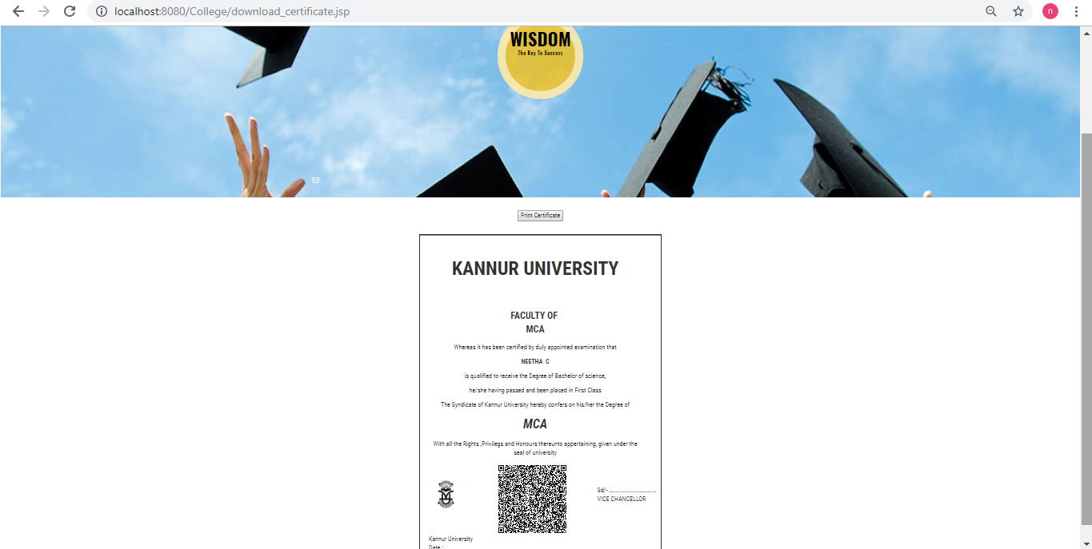
View applied students
Generate certificate

Slide 35
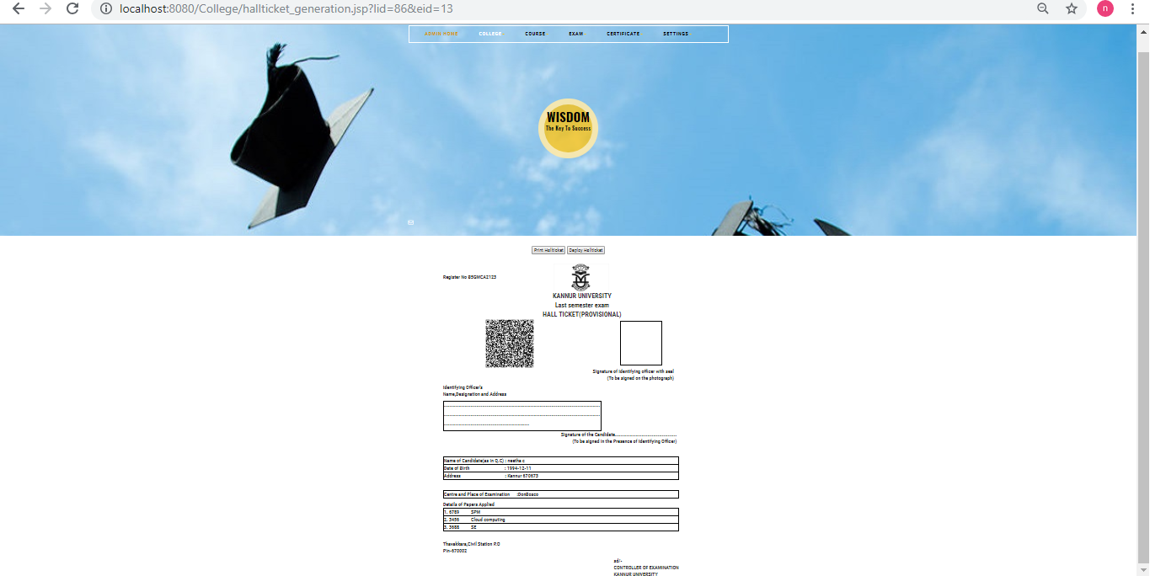
Generate hall ticket

Slide 36
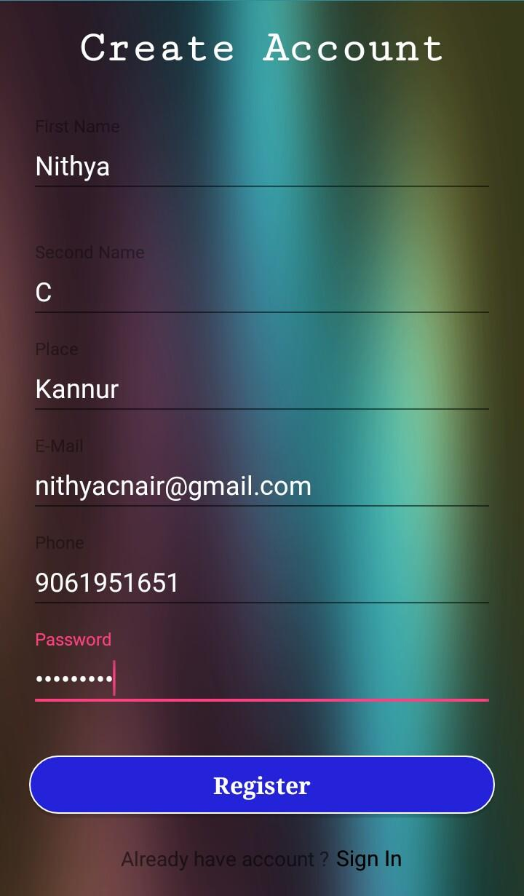
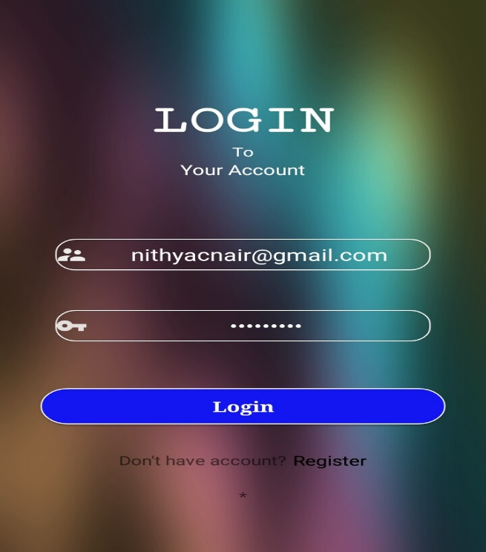
Verification App
Registration form
Login form

Slide 37
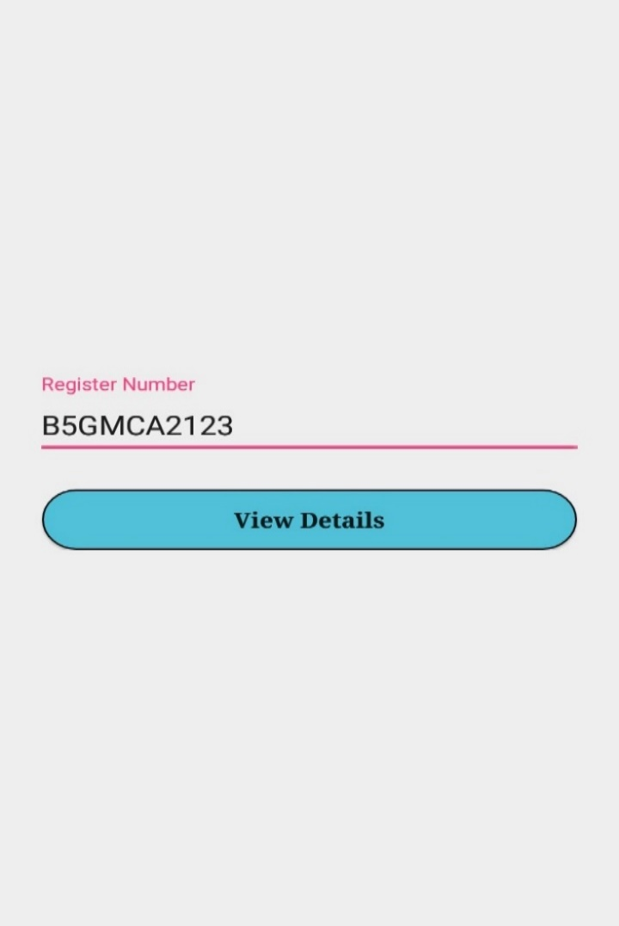
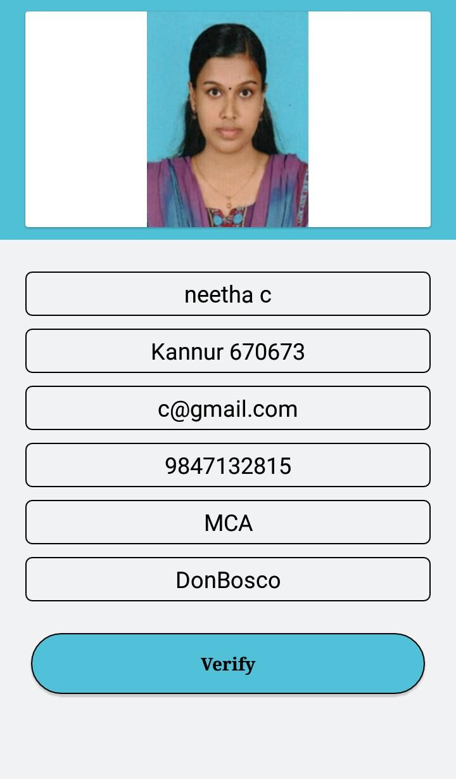
Search student
Student Details

Slide 38
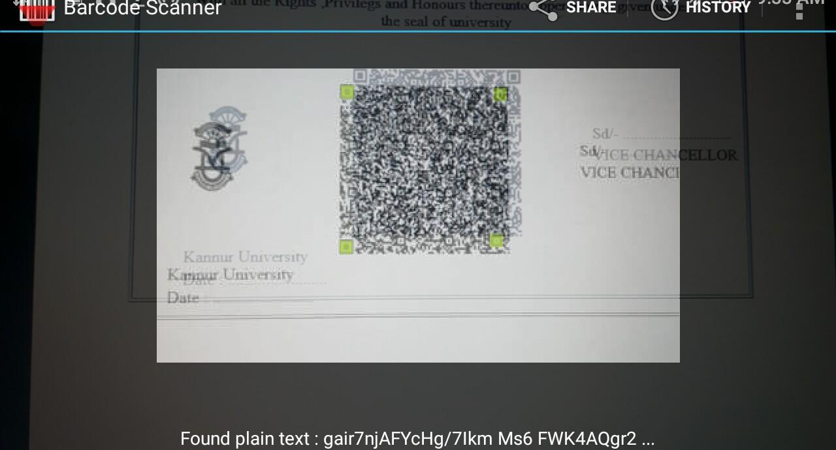
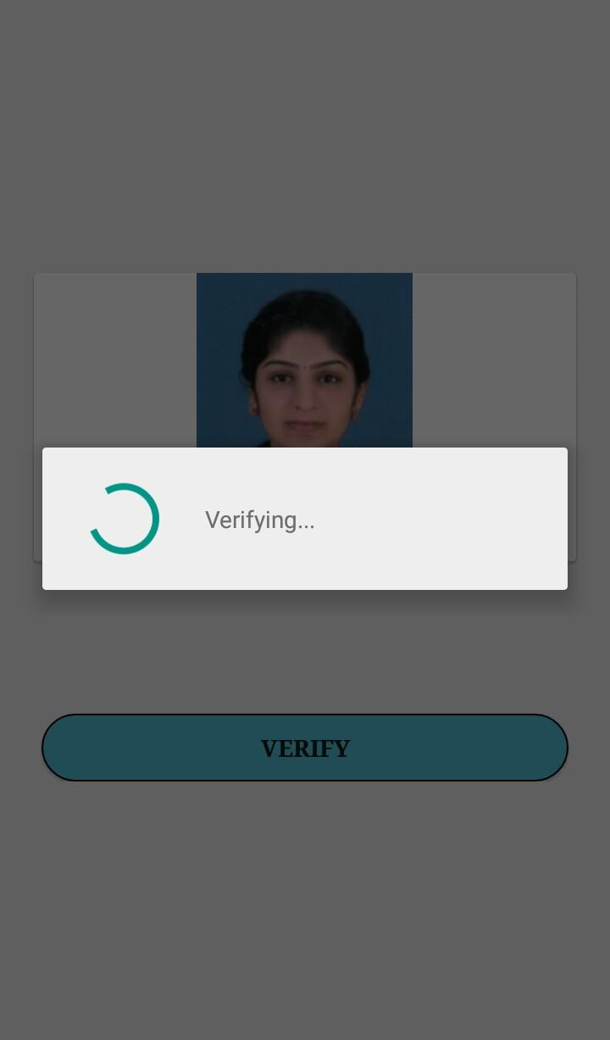
Scan QR code
Verify student

Slide 39
Thank You…

